Slide 1

Store Sales Prediction
By: Supreet Dang

Slide 2
Predicting sale is one of the important goal for any investor / business entity. If we can accurately predict sales, it gives the owner / business to predict inventory and / or make future investments
Introduction:

Slide 3
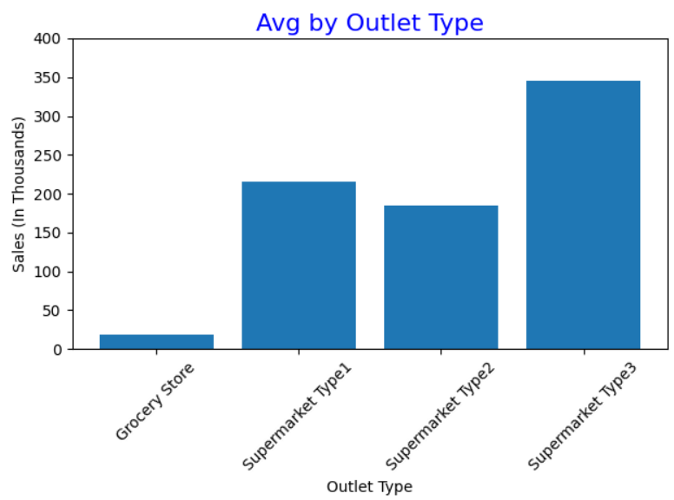
Avg sales by Outlet Type
Supermarket Type 3 has the drives the most amount sales

Slide 4
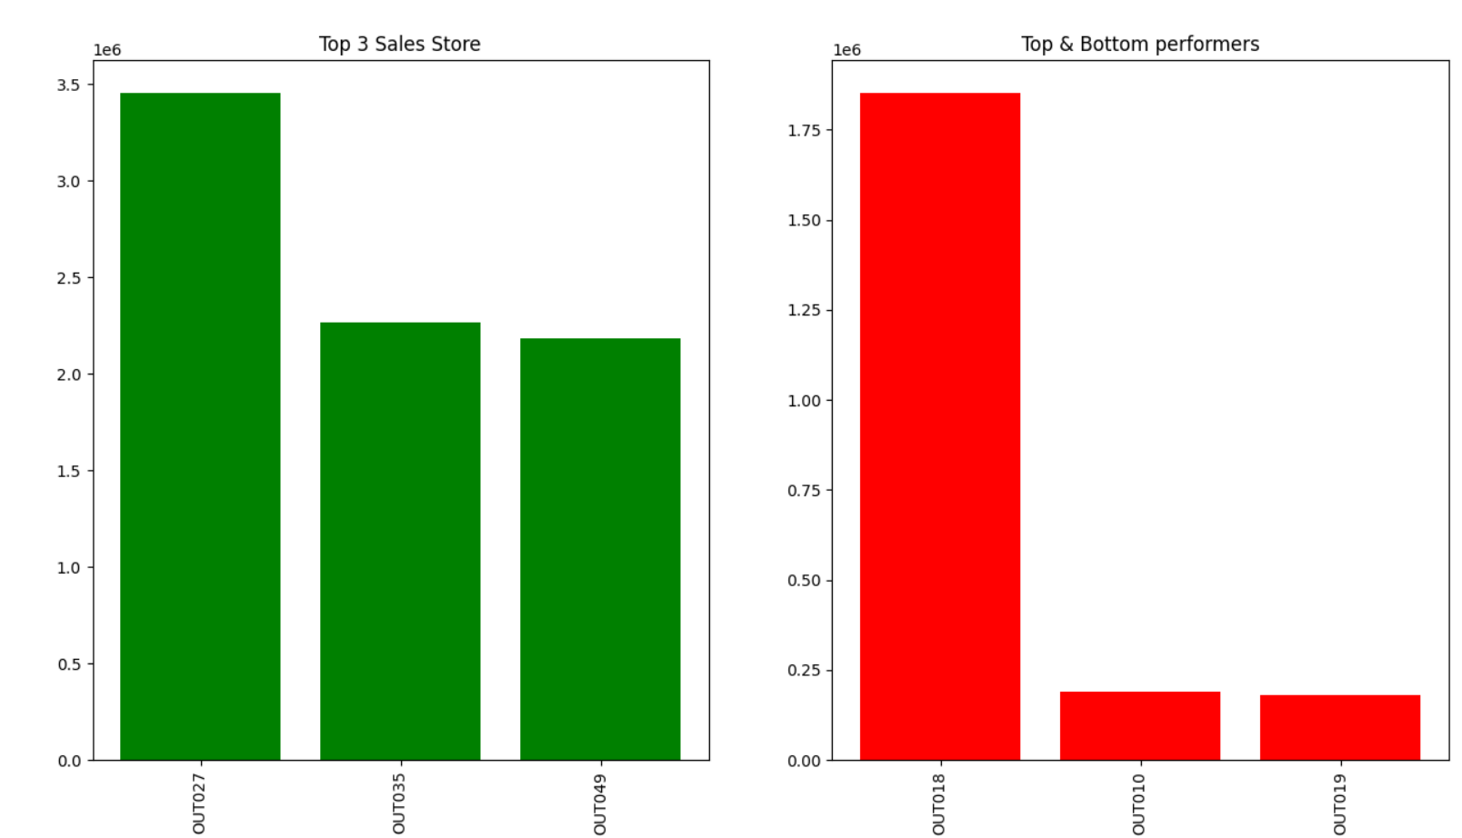
Top & Bottom Performers
This graphical presentation that identifies Top and Bottom 3 Stores with sales

Slide 5
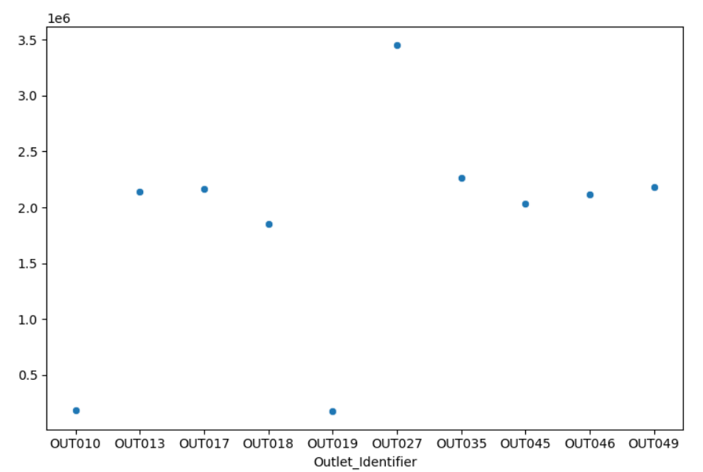
Sales by All Stores
Identified sales from all Stores

Slide 6
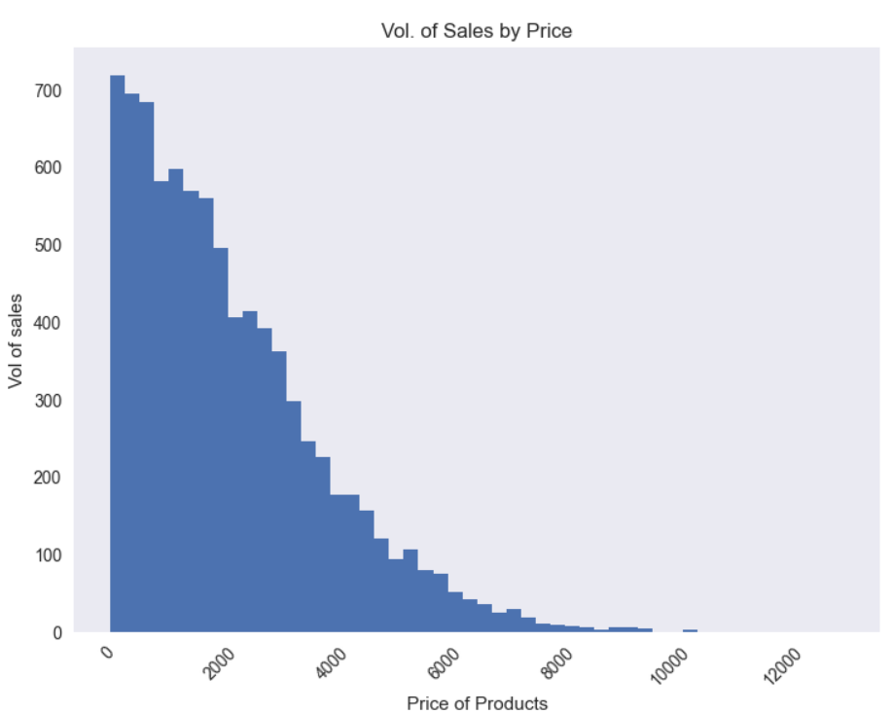
Vol of sales by Price
This graph represents that products that are below $2,000 in cost drive maximum sales

Slide 7
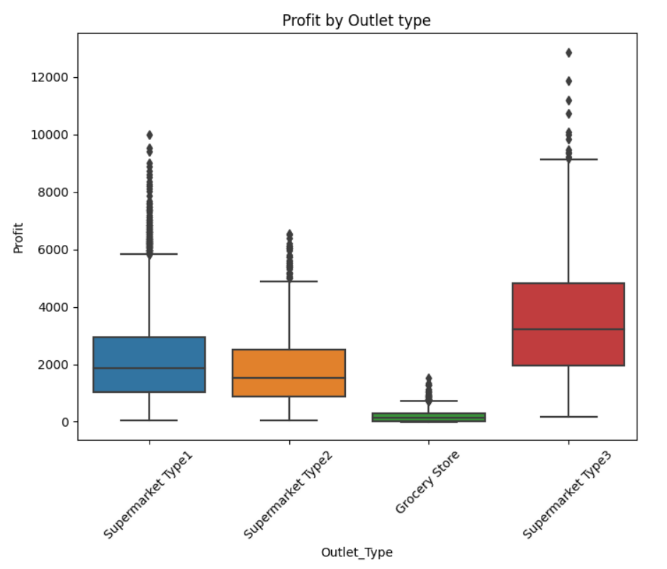
Profit by Outlet
Supermarket Type 3 drives max profit. Their Mean profit is $4,000 which is higher than the max profit earned by Supermarket Type 1
Other 2 markets Supermarket Type 2 and Grocery Stores are much lower in profit

Slide 8
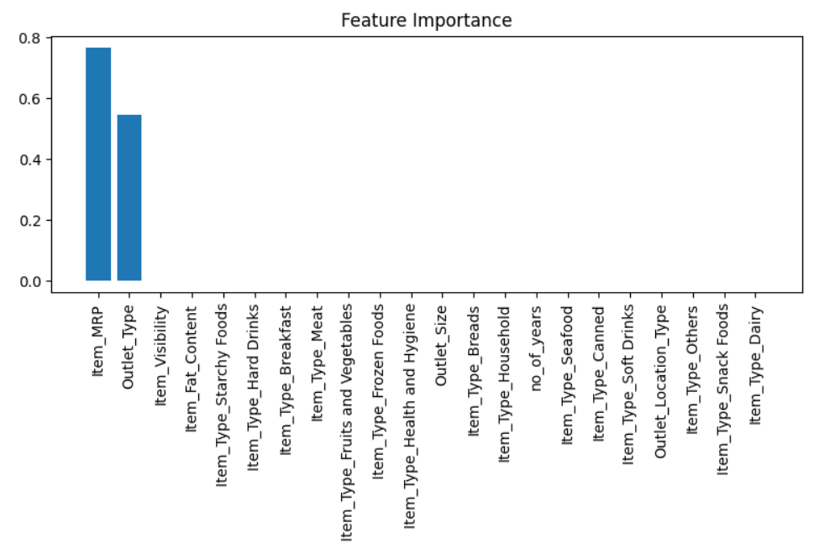
Important Features
The 2 Primary Data points are
MRP
Outlet Type

Slide 9
Data Accuracy
Regression Models | Accuracy (Testing dataset)
KNN | 40.39%
Linear | 50.24%
Random Forest | 60.28%
We ran 2 Machine Learning models & also tuned some parameters.
Our best model is Random Forest with an accuracy of 60.28% a Mean Error of $728

Slide 10
Random Forest is the best model to predict with MRP and Outlet Type being the primary predicting factors
Summary

